Slide 1
Flight reservation

Slide 2
Technologies use
Html
Css
TypeScript
Bootstrap
Node JS
Angular framework

Slide 3
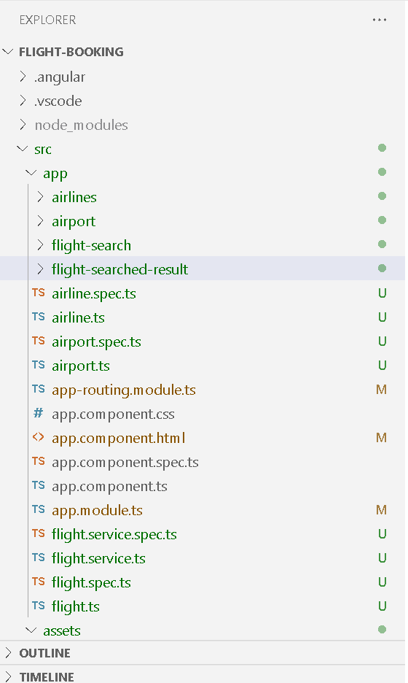
The project structure

Slide 4
Short description
Component created
Airline
Airport
Flight-search
Flight-search-result
Service
FlightService
Model
Flights

Slide 5
To run the project
First run the command as npm install inside a : flight-booking folder.
Then run the command as ng serve
After compiled program successfully open the browser and write the URL as http://localhost:4200

Slide 6
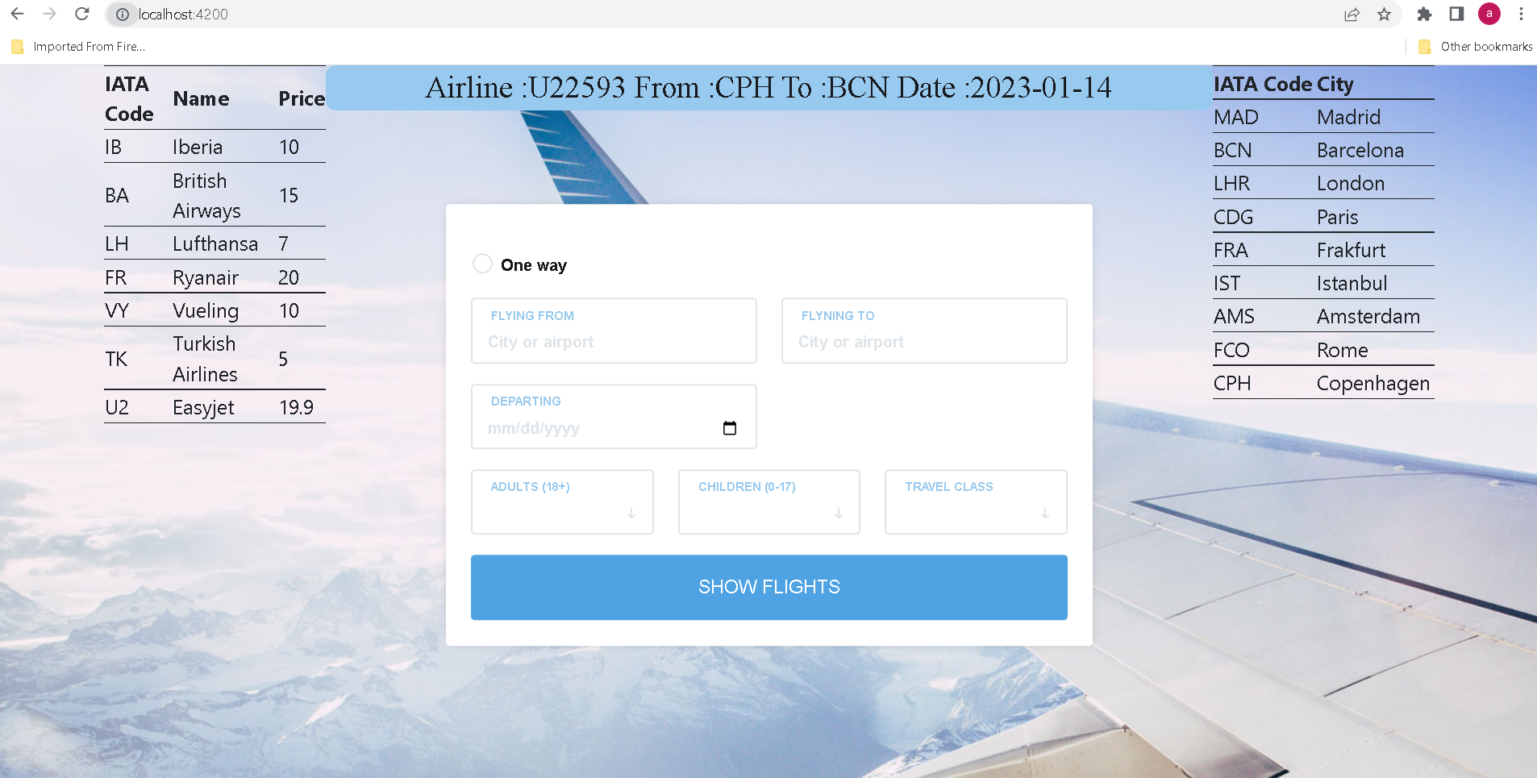
Landing screen

Slide 7
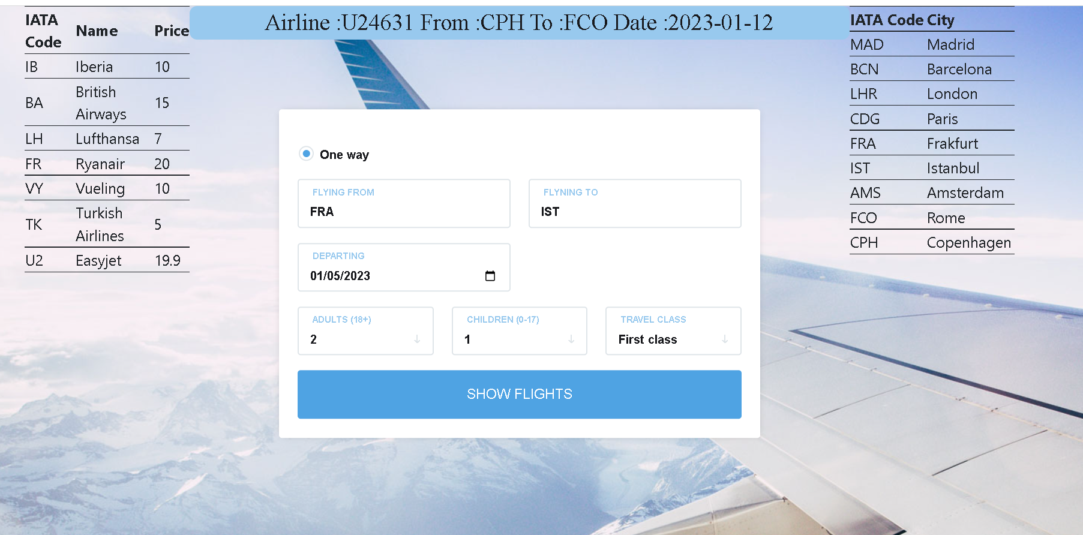
We can search the flight

Slide 8
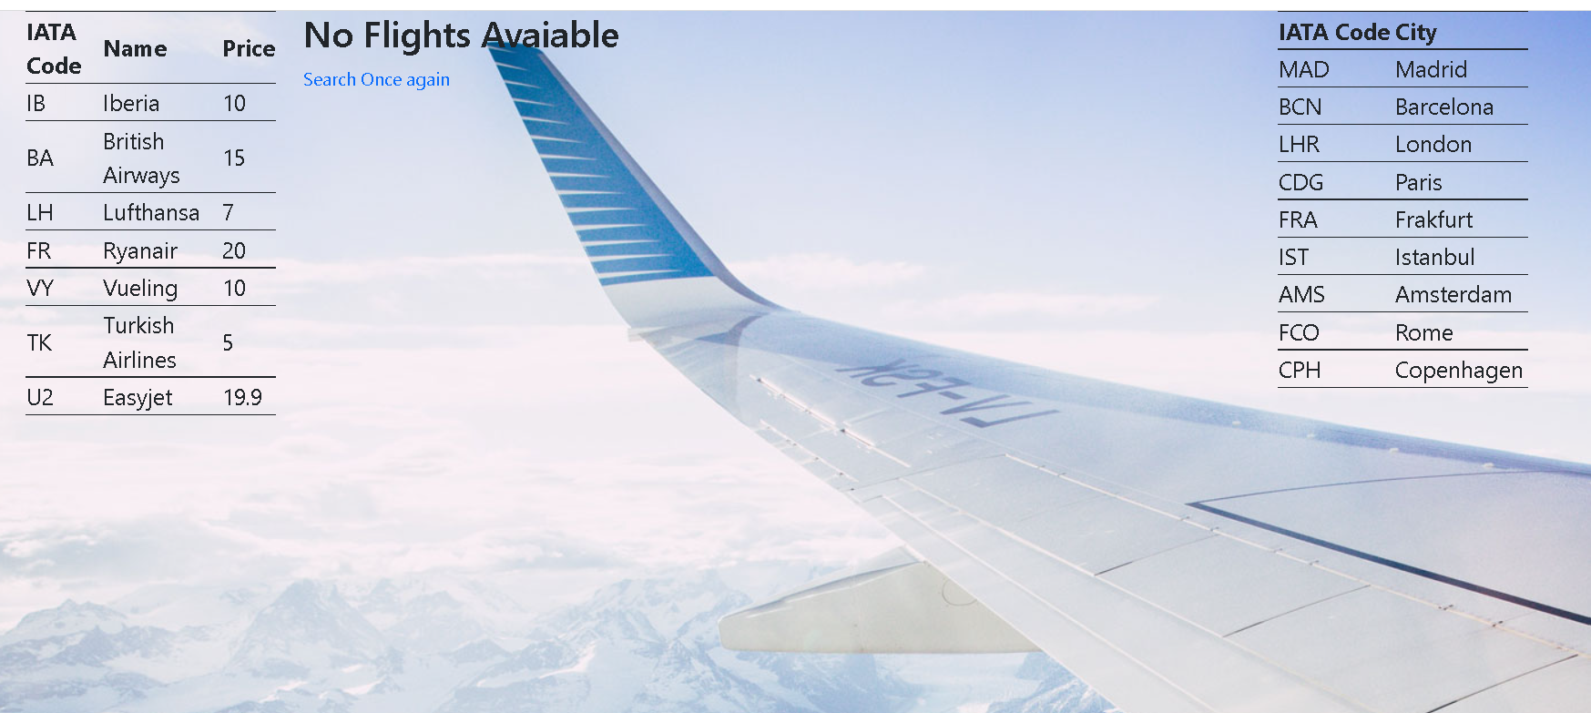
If there is not flight available then we will get the result as

Slide 9
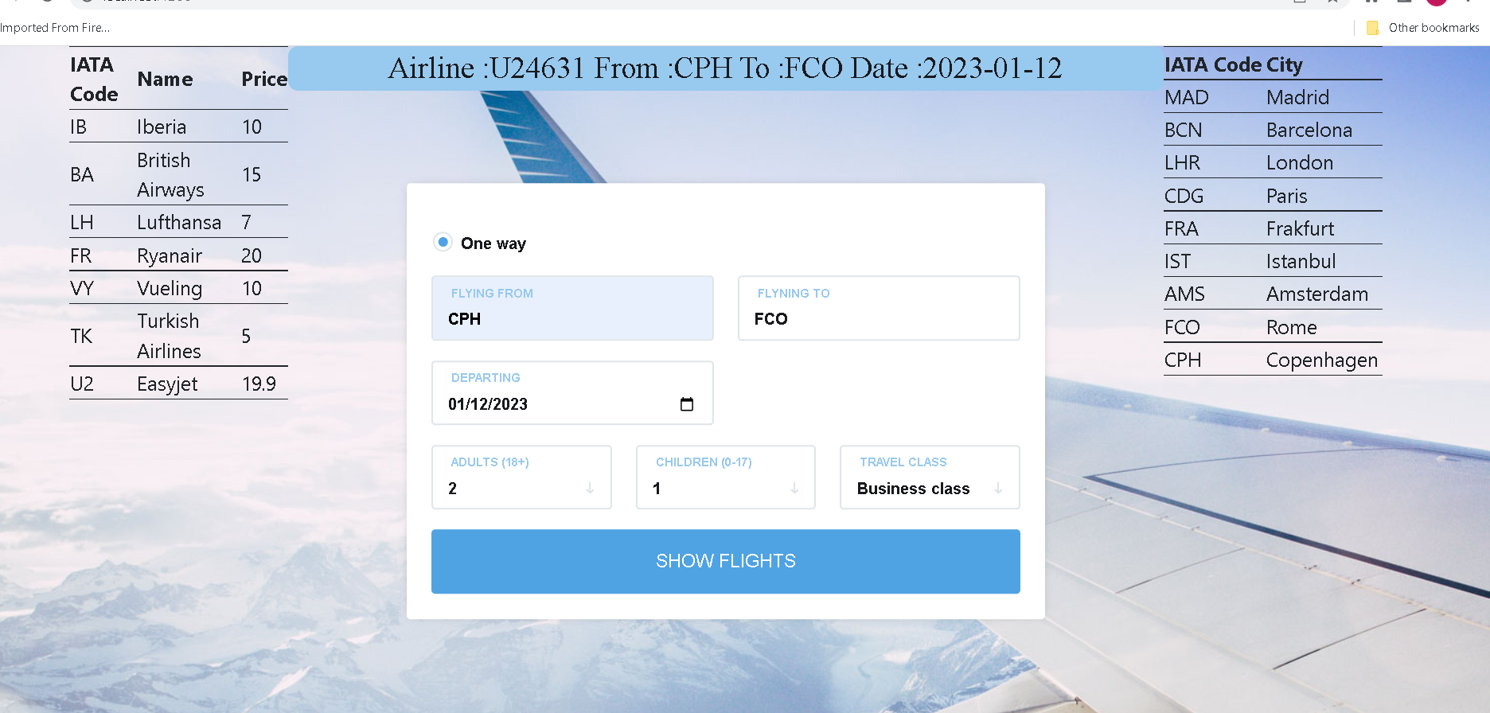
Search with available flight

Slide 10
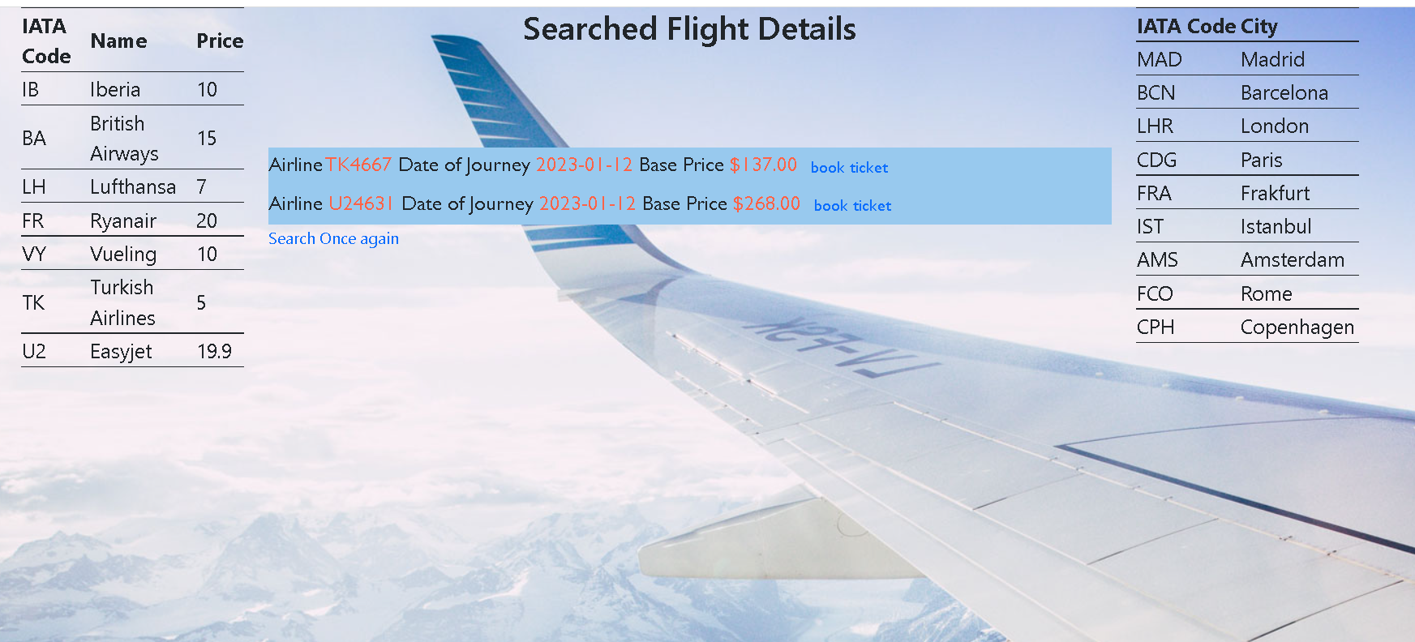
If flight are available then we will get the result as

Slide 11
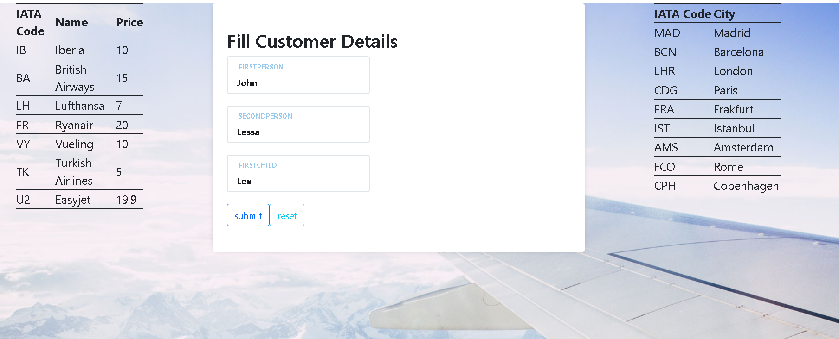
After provided customer details

Slide 12
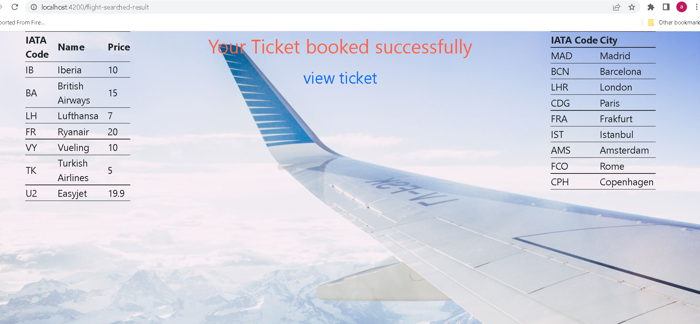
It book the flight

Slide 13

To view the ticket we need to click on hyperlink

Slide 14
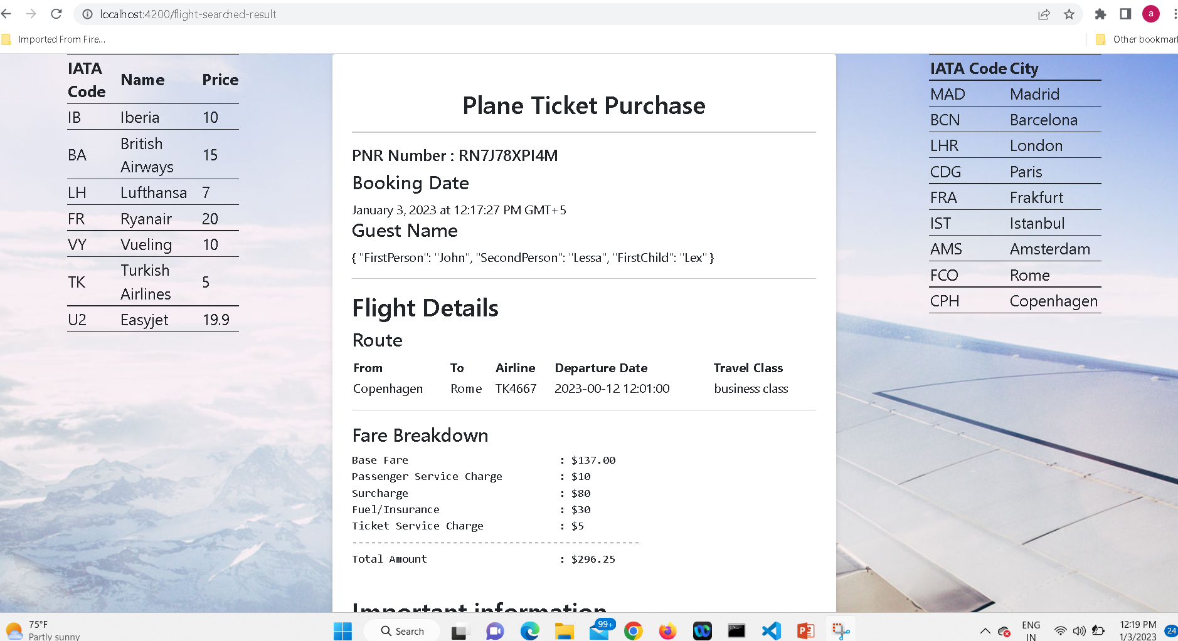
Booked the ticket

Slide 15
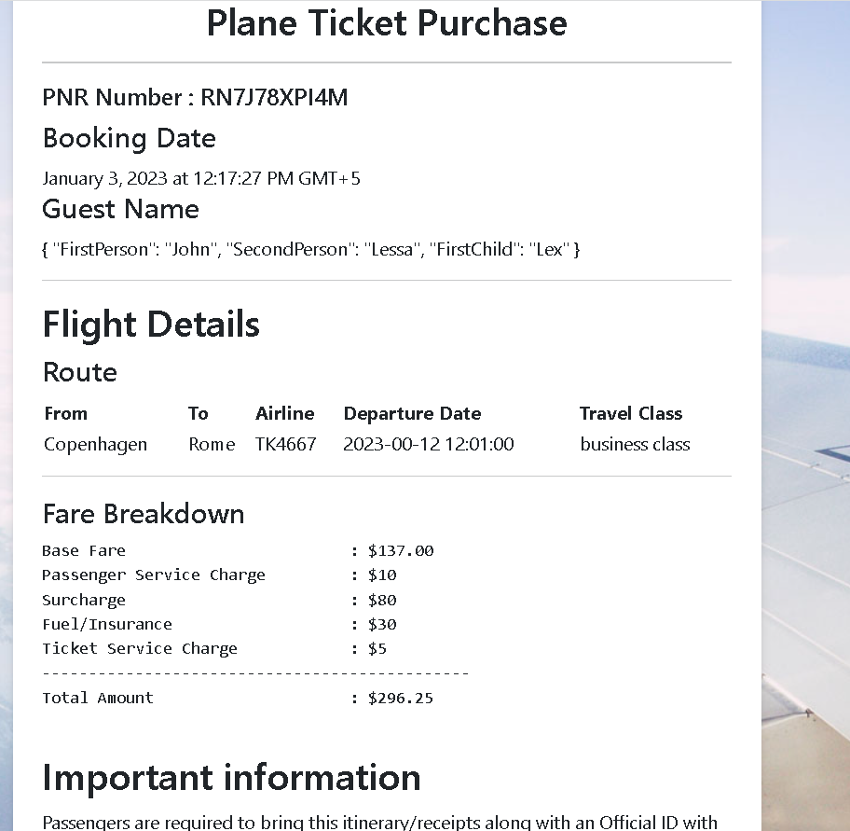
You can view the ticket in browser

Slide 16
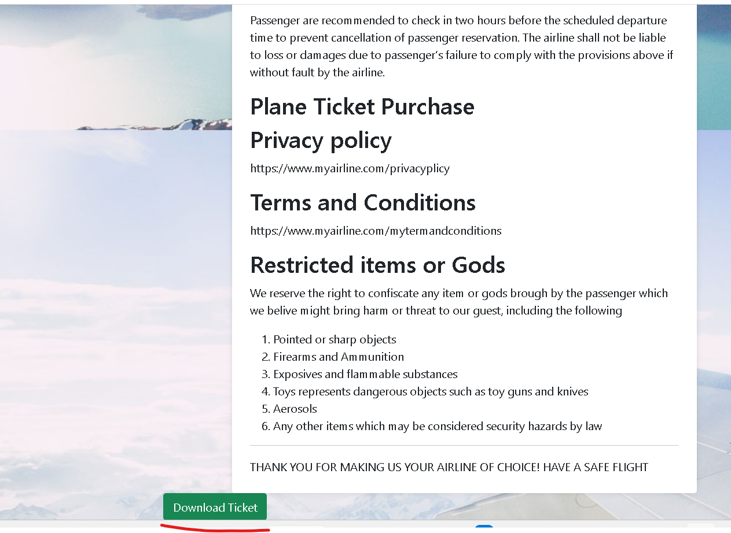
You can download the ticket by clicking on button as

Slide 17
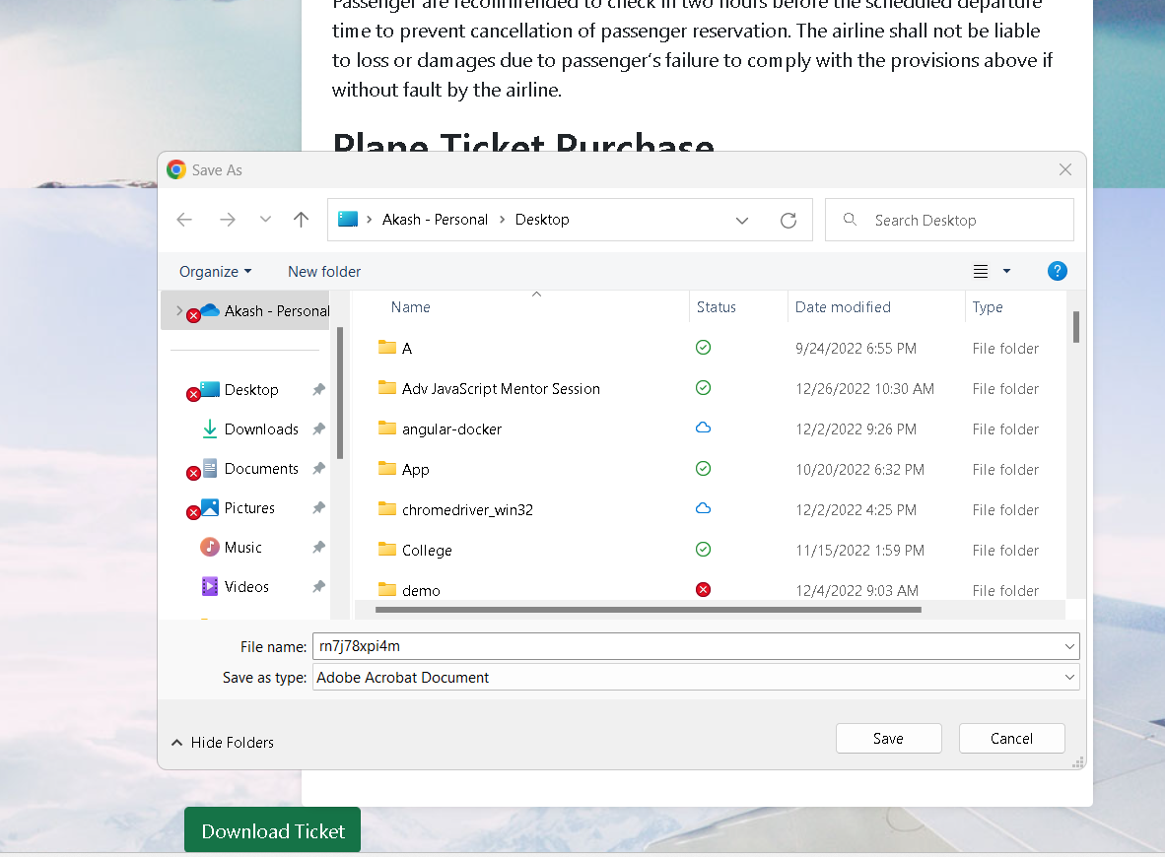
The ticket save with auto random pnr number

Slide 18
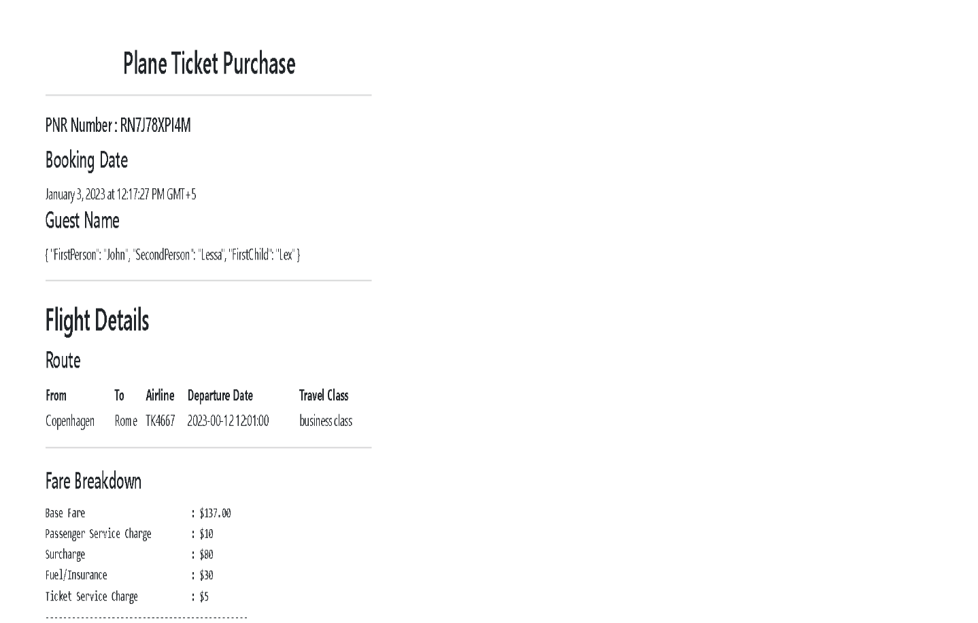
View the ticket in pdf format.

Slide 19
